Slide 1
Quest

Slide 2
Team Members:
1.Nada Amr Attia 19P1621
2.Alaa Mohamed Hamdy 19P6621
3.Anas Salah Abdelrazik 19P9033
4.Ahmed Amr Elgayar 19P8349
5.Ahmed Akram Mohamed 19P4777
6.Mohamed Saber Mohamed 19P9544

Slide 3
AGENDA
Introduction
Main Functionalities
Diagrams
Website Usage

Slide 4
What is quest?
Quest is a website that helps people have fun in Egypt. You do not need to go to the same place every time because you do not know other places, this is where Quest turn comes in.
It offers variety of places to visit,
Offering promotions and discounts
Provides extra services such as car renting
Provides tour guides for foreigners and for citizens as well.
Find you the best place to go to according to your preferences and also your budget.
Quest helps you also organize trips so that you can search for hotels or even join a trip organized by quest .
Helps marketing for local businesses in Egypt thus helping Egypt economically. Quest is a joy-safer!.

Slide 5
Main functionalities
•Provide users with a wide range of restaurants, activities, and hotels recommendations in Egypt’s
•Provide user with a list of offered trips all over Egypt
•Provide user with car renting facilities
•Provide users with a tour guide if requested.
•Act as a marketing agency for local businesses
•Allow user to rate places
•Allow user to reserve hotels
•Allow user to search outings and filter results
•Allow user to pay online or cash for the services
•Allow user to view restaurants and places descriptions and view other users recommendations and comments

Slide 6
Use Case Diagram

Slide 7
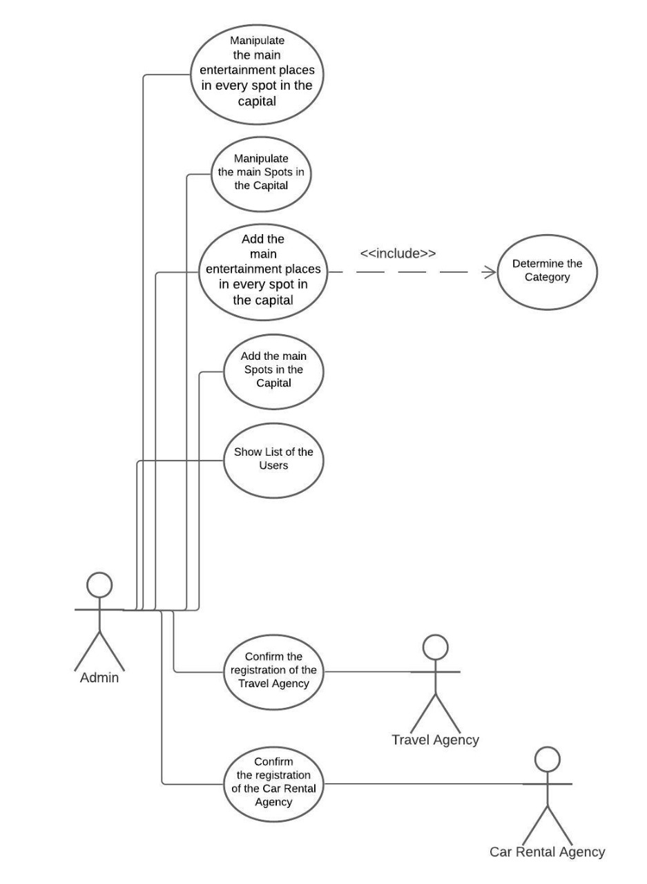
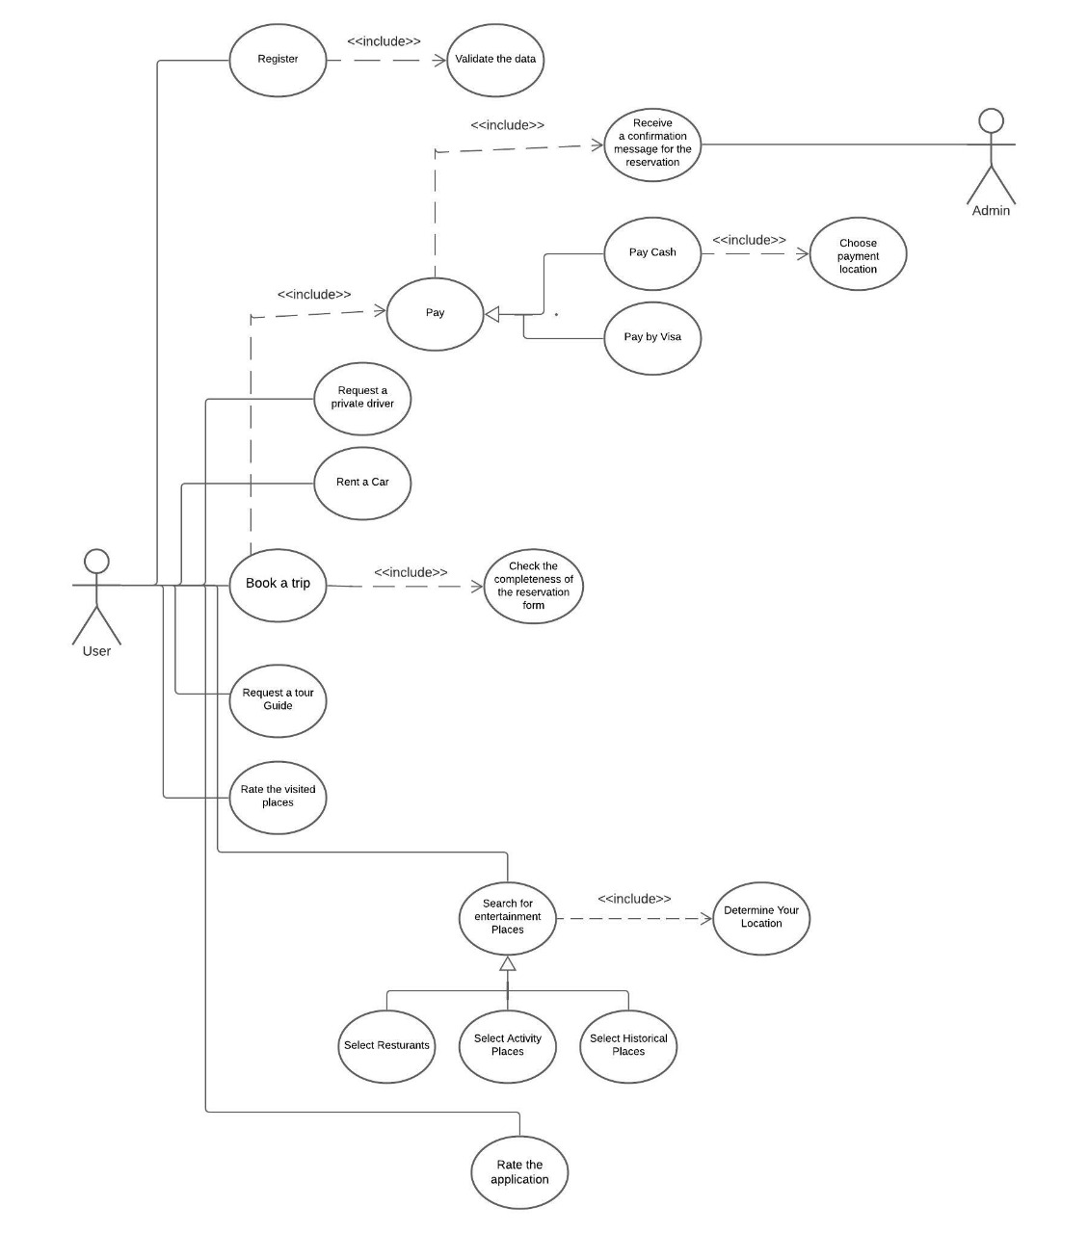

Slide 8
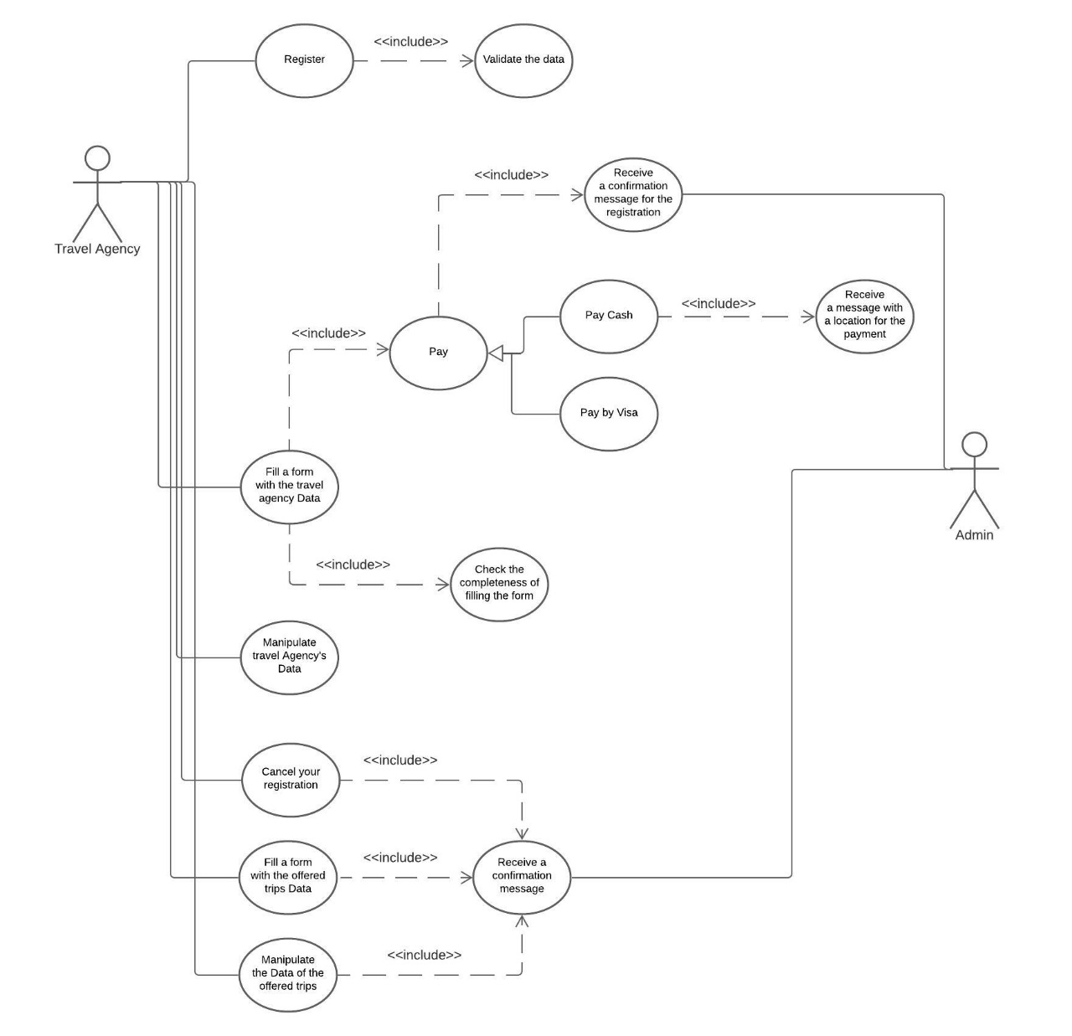
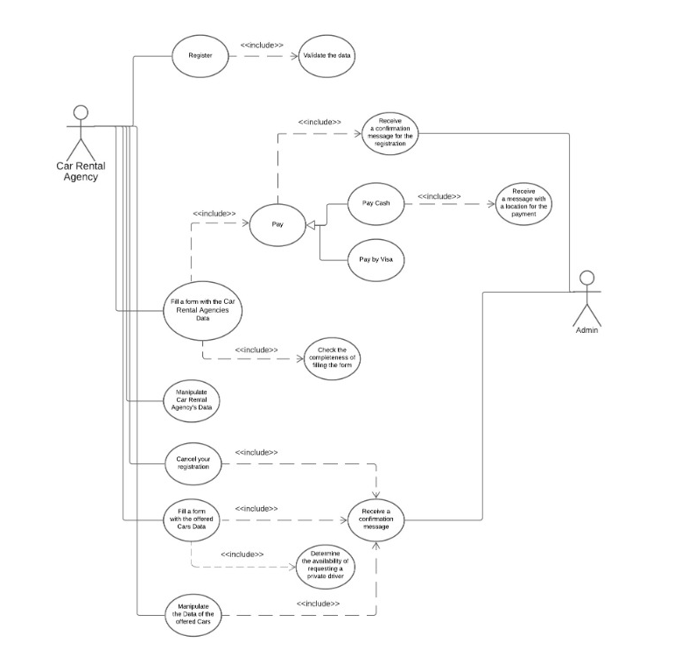

Slide 9
Component Diagram

Slide 10
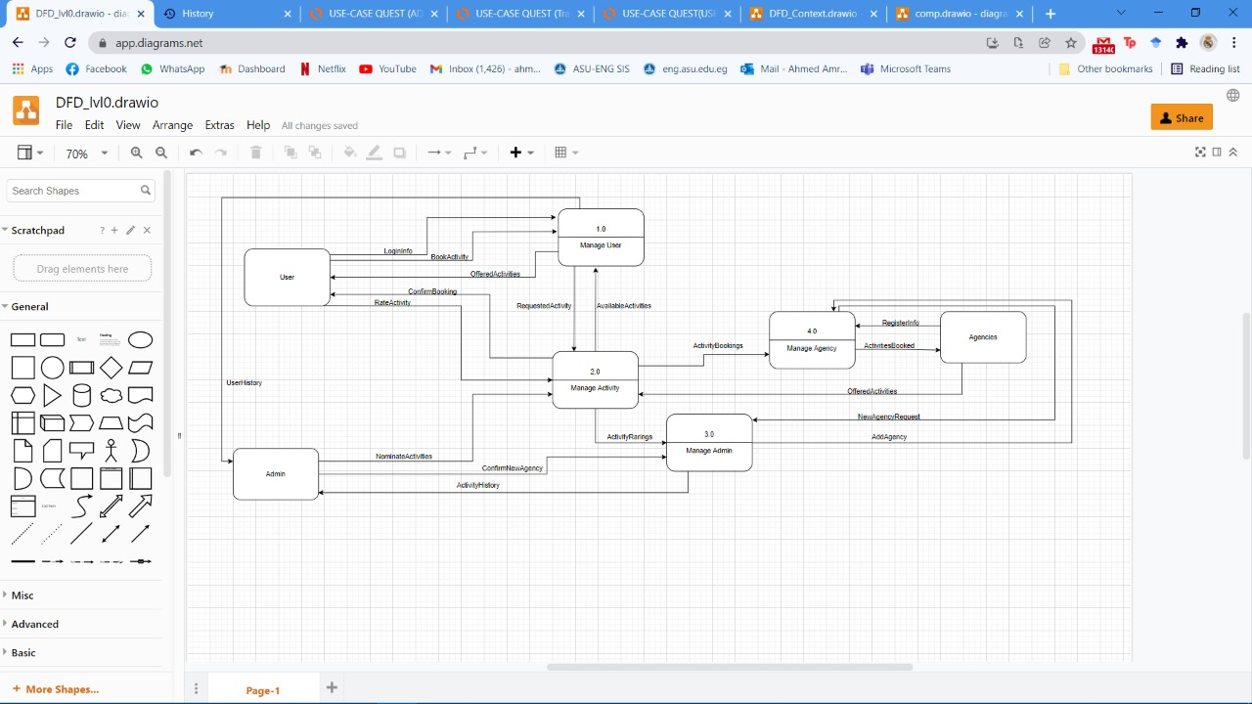

Slide 11
Architecture model

Slide 12
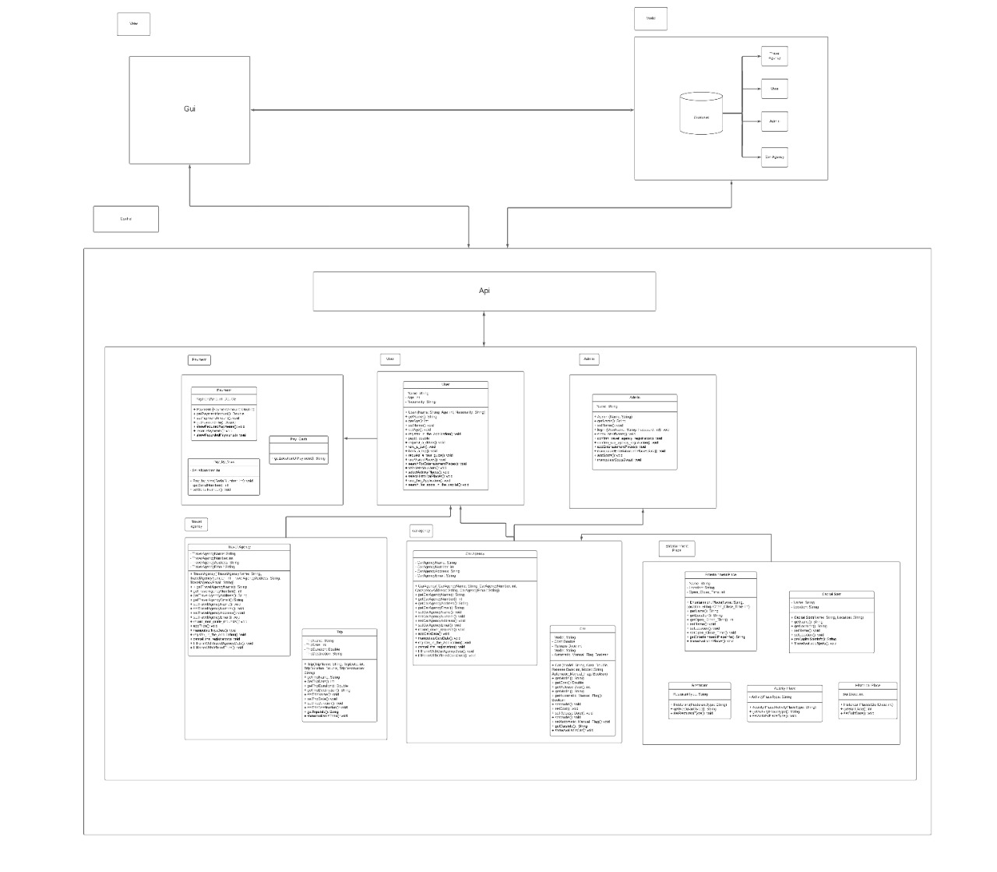

Slide 13
Data Flow Diagram

Slide 14
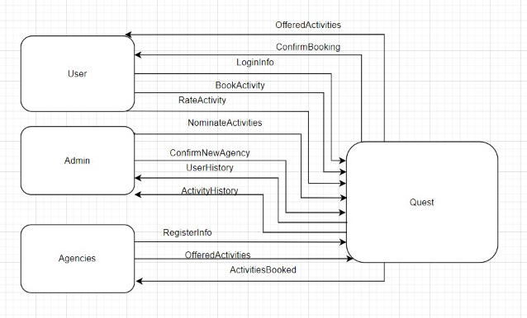
CONTEXT DIAGRAM

Slide 15
LEVEL 0

Slide 16
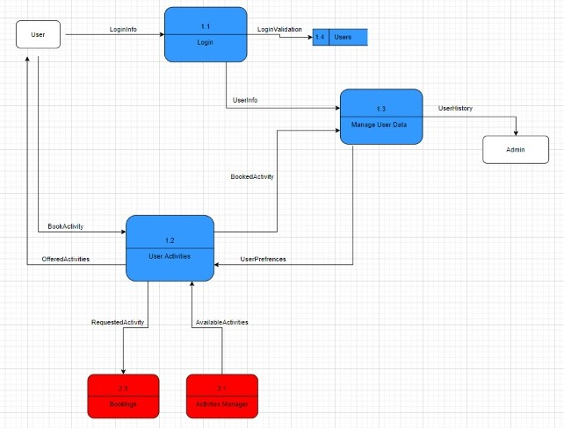
LEVEL 1

Slide 17
Class Diagram

Slide 18
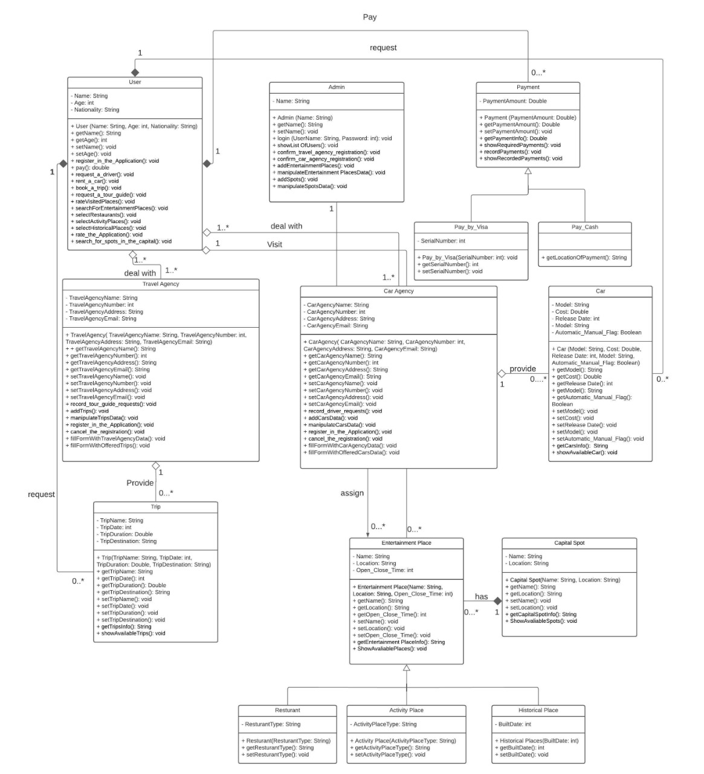

Slide 19
State Diagram

Slide 20
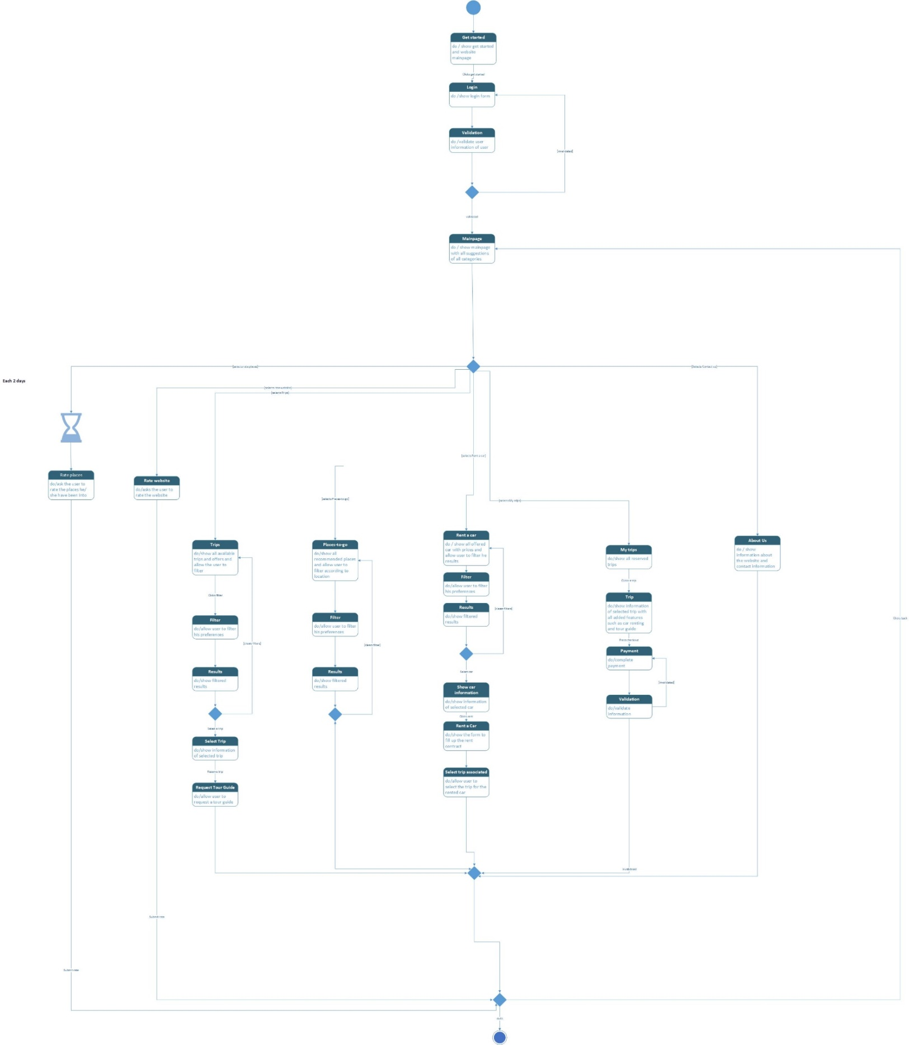

Slide 21
SEQUENCE Diagram

Slide 22
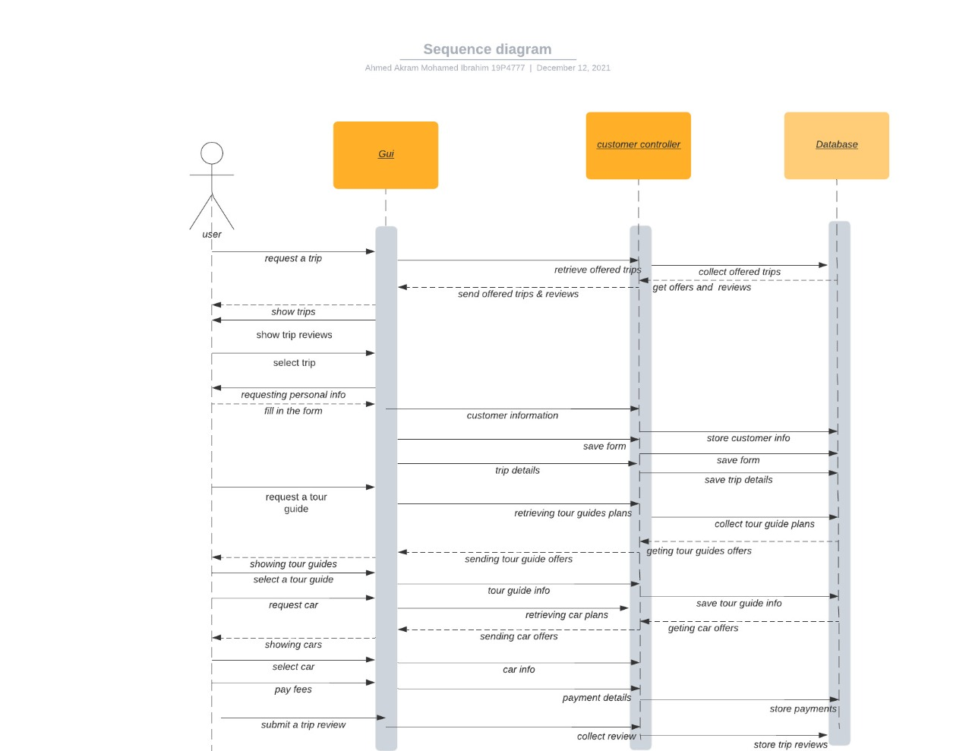

Slide 23
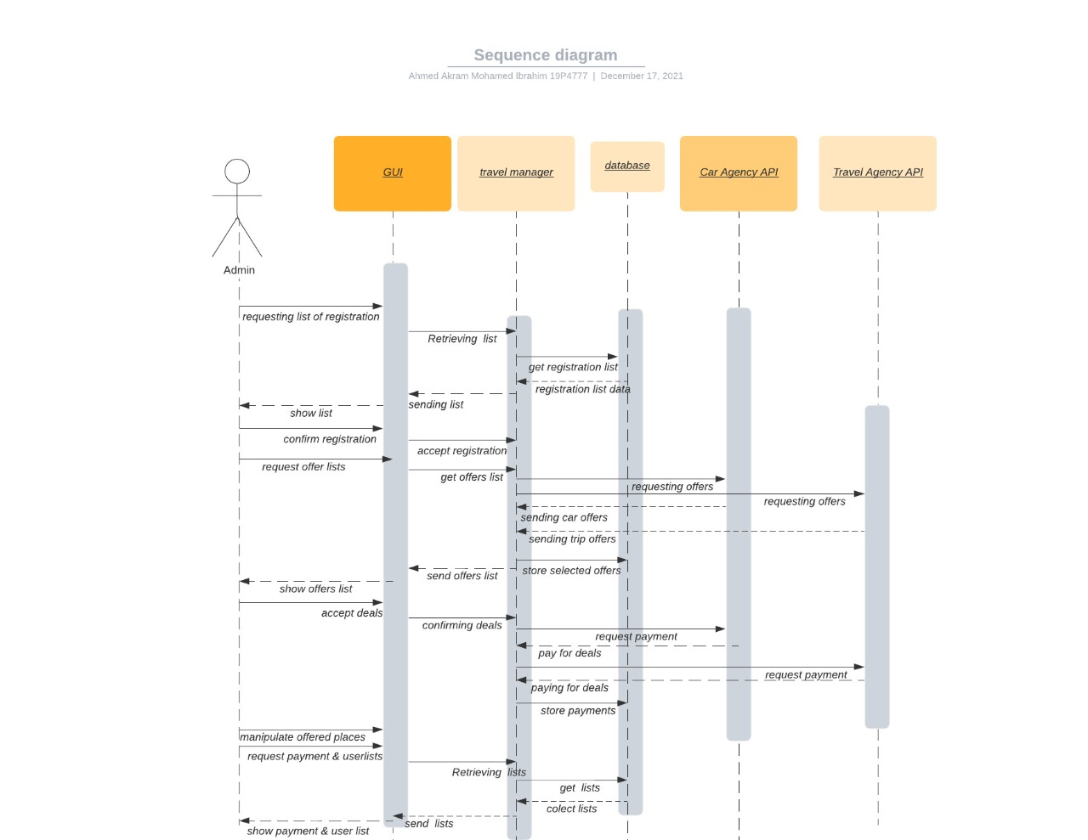

Slide 24
CLIENT-OBJECT RELATIONSHIP

Slide 26
Database schema

Slide 27
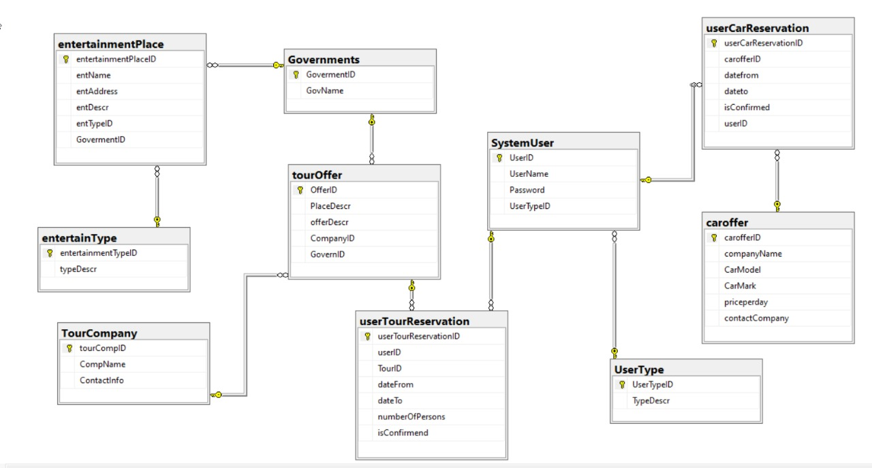

Slide 28
The Website & its usage

Slide 29
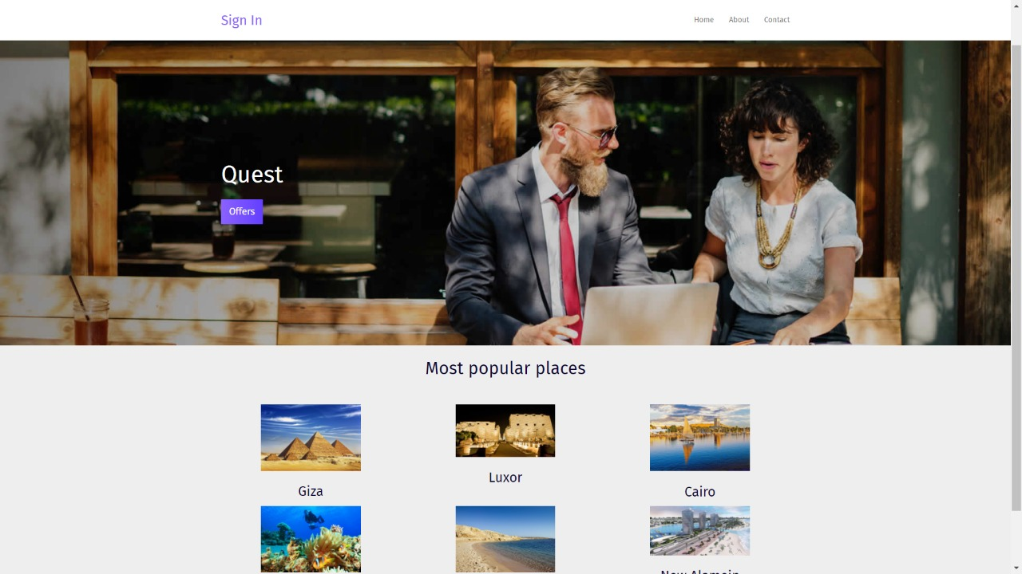
Landing page when you first open the website

Slide 30
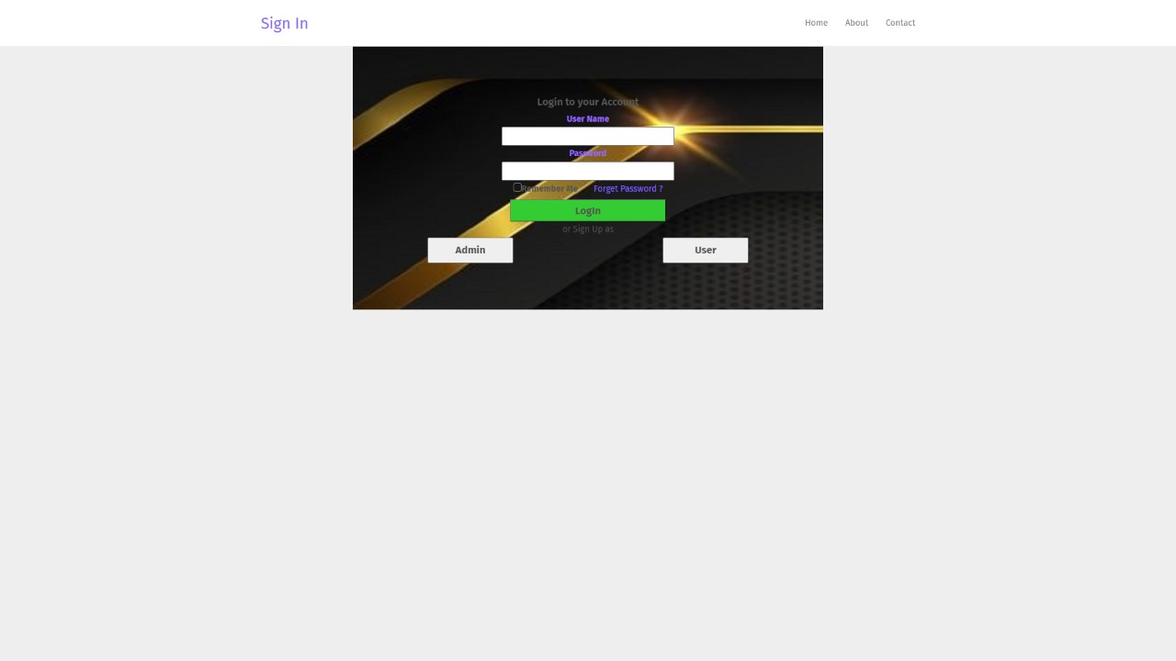
As a client, you either sign up if you are new or log in

Slide 31
log in page

Slide 32
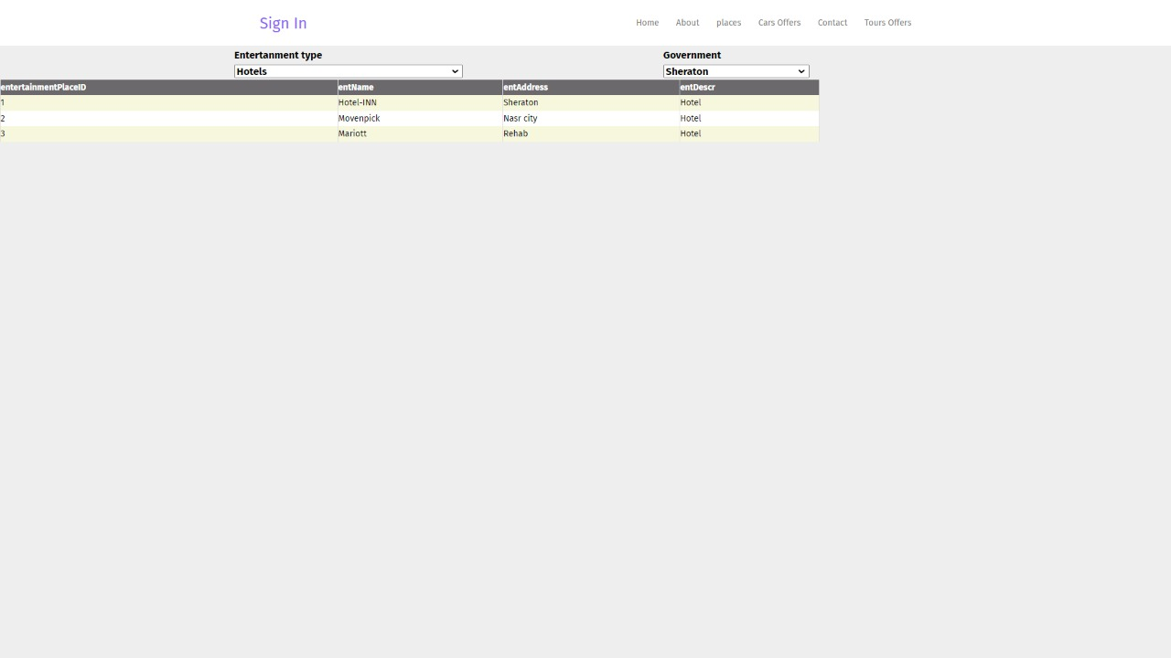
If you clicked on places, all entertainment places will be available for you by filtering the results according to your preferences

Slide 33
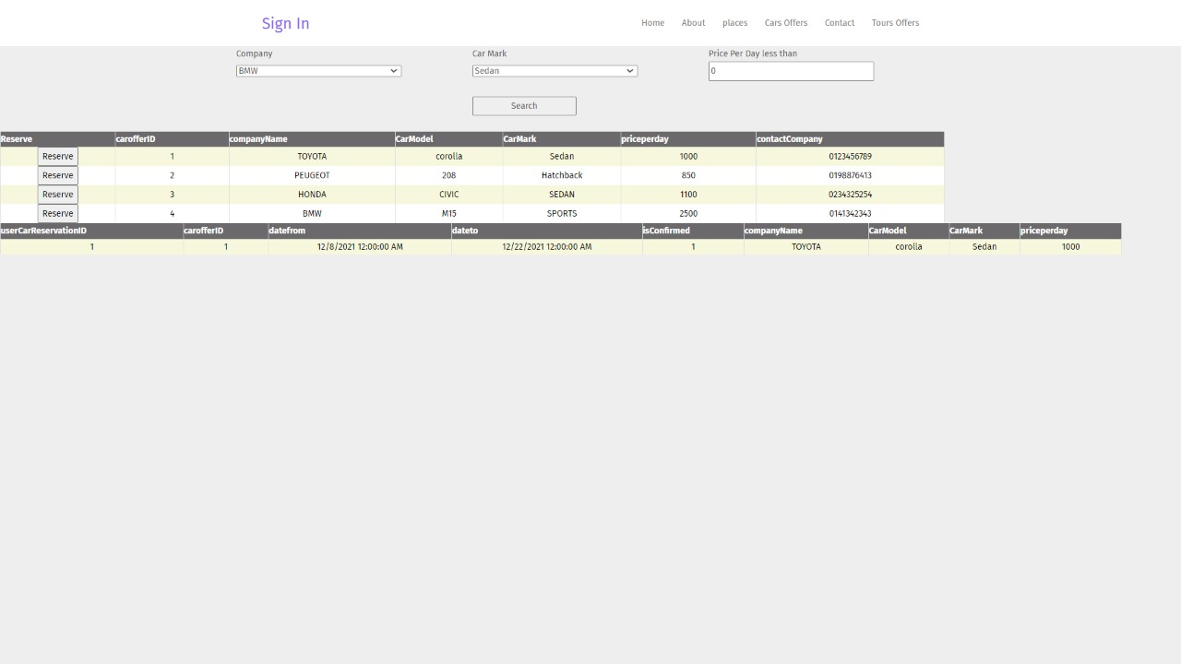
If you want to rent a car you click on cars offers and filter the results according to your preference and reserve the car you want

Slide 34
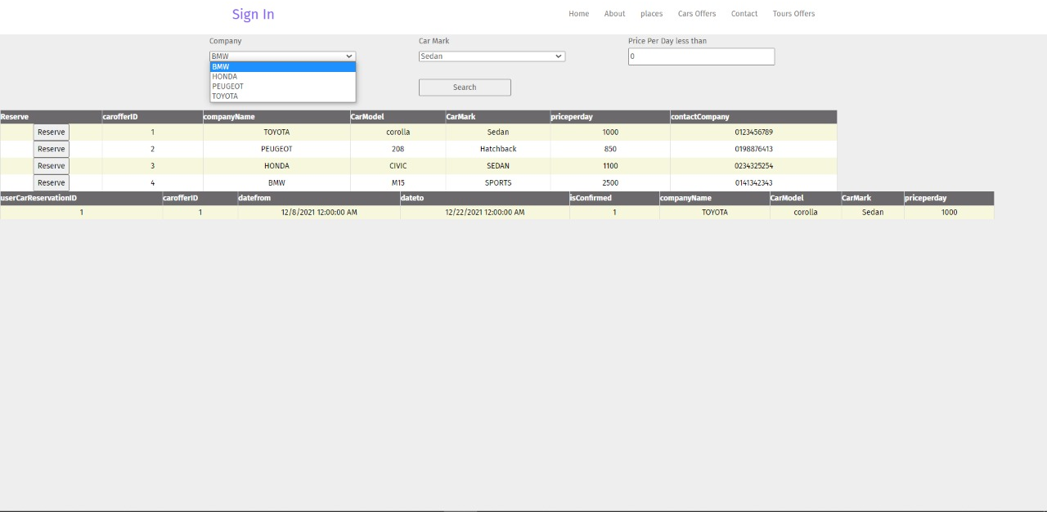
Filtering results

Slide 35
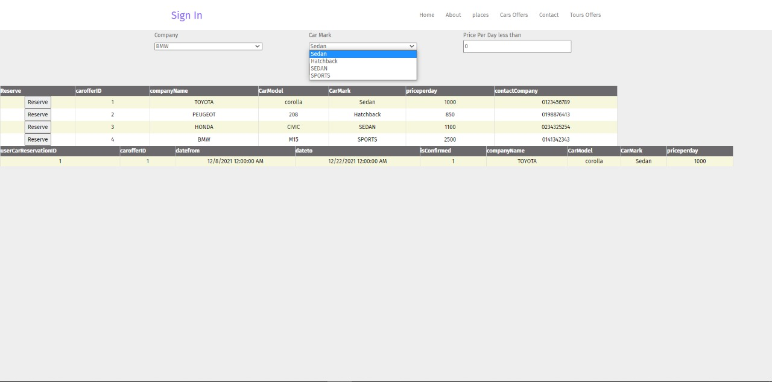

Slide 36
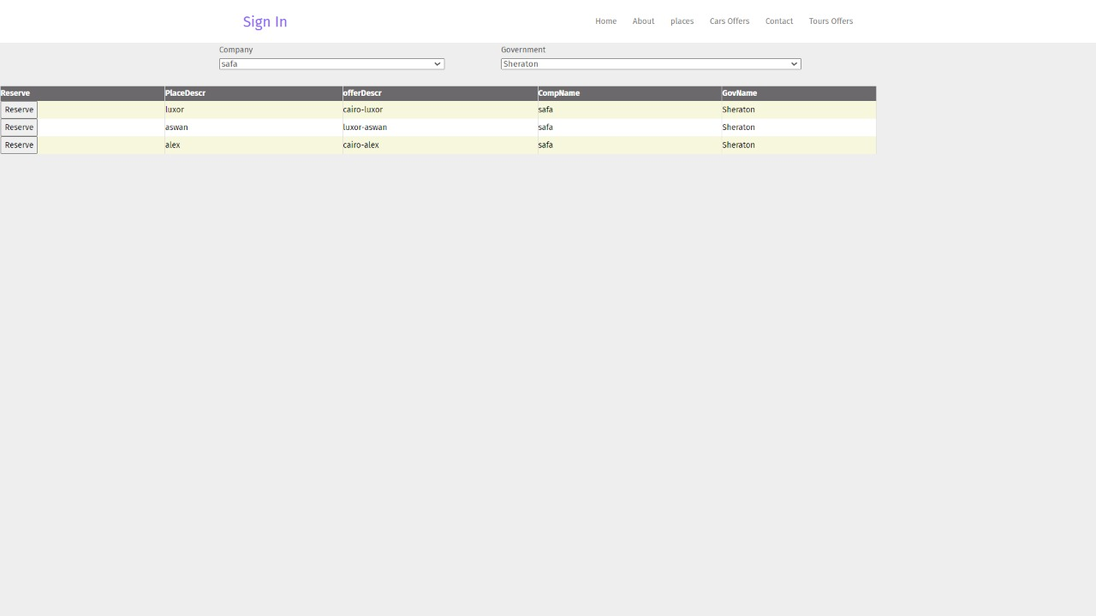
Reserve by clicking on the reserve button

Slide 37
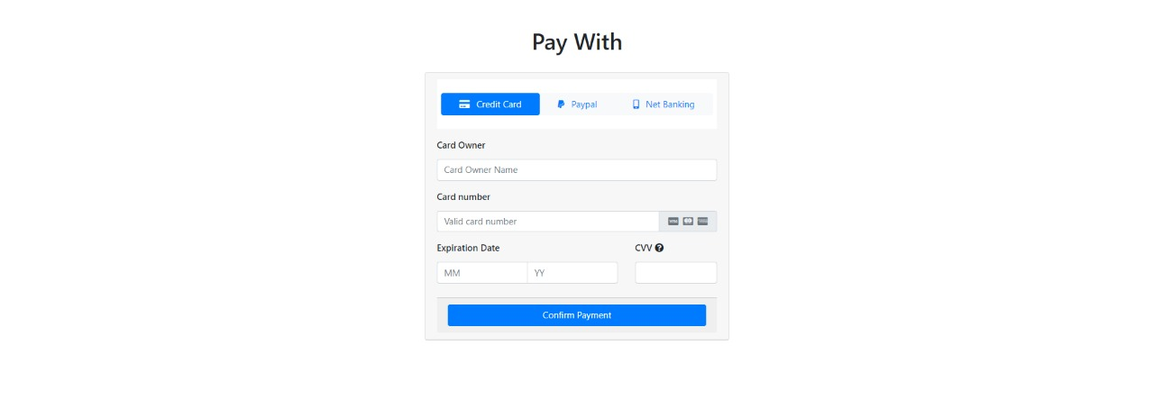
To pay for your services

Slide 38
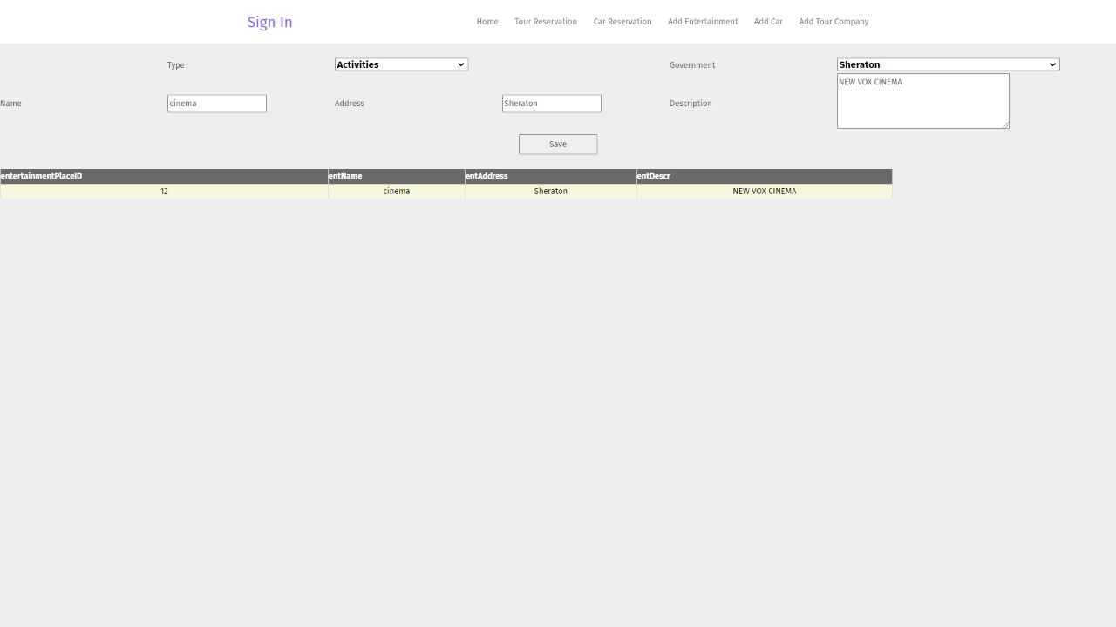
If the admin clicked on add entertainment he will be able to add/modify entertainment places on the website

Slide 39
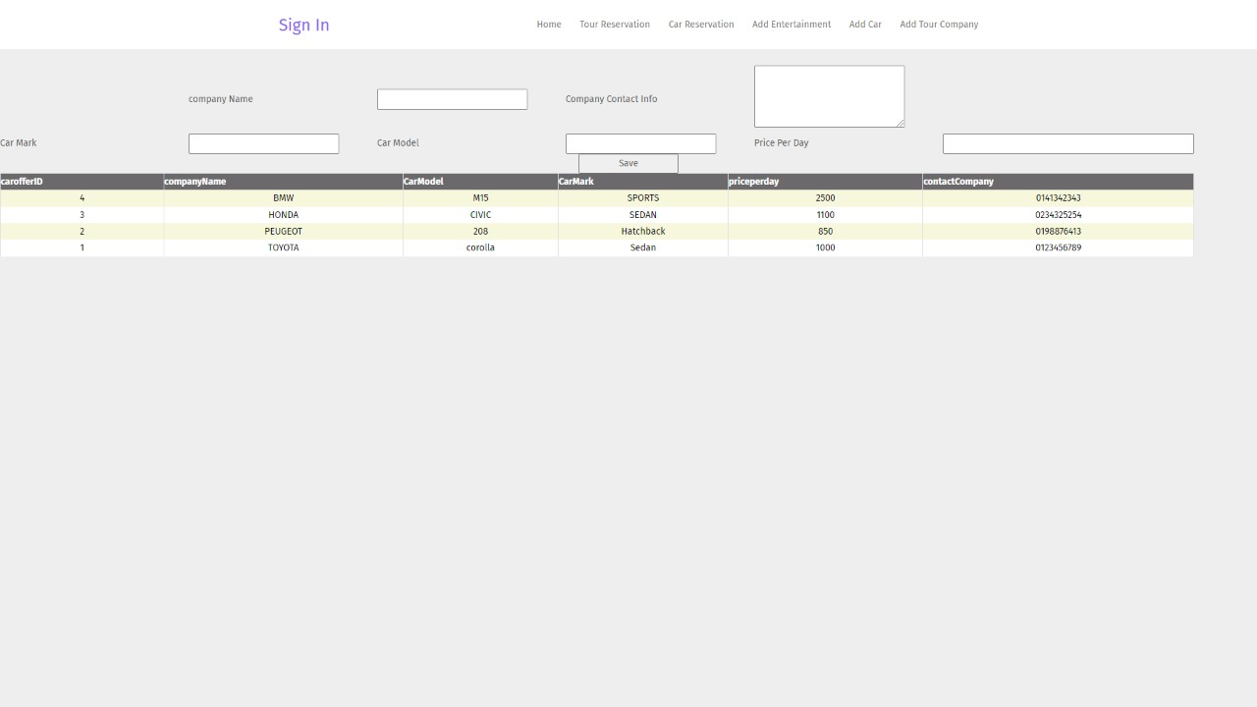
If the admin clicked on add car he will be able to add/modify offered cars on the website

Slide 40
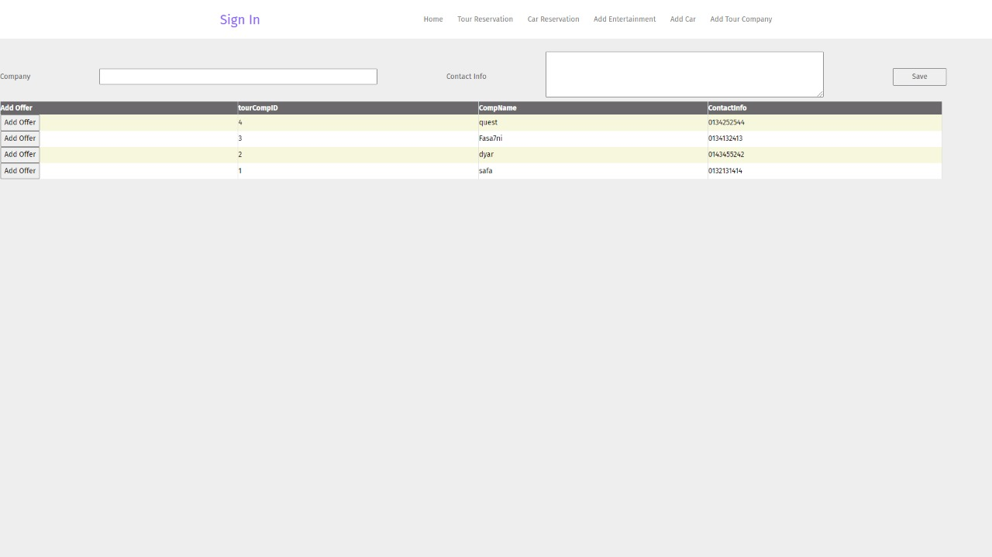
If the admin clicked on add tour company he will be able to add/modify offered tours on the website

Slide 41
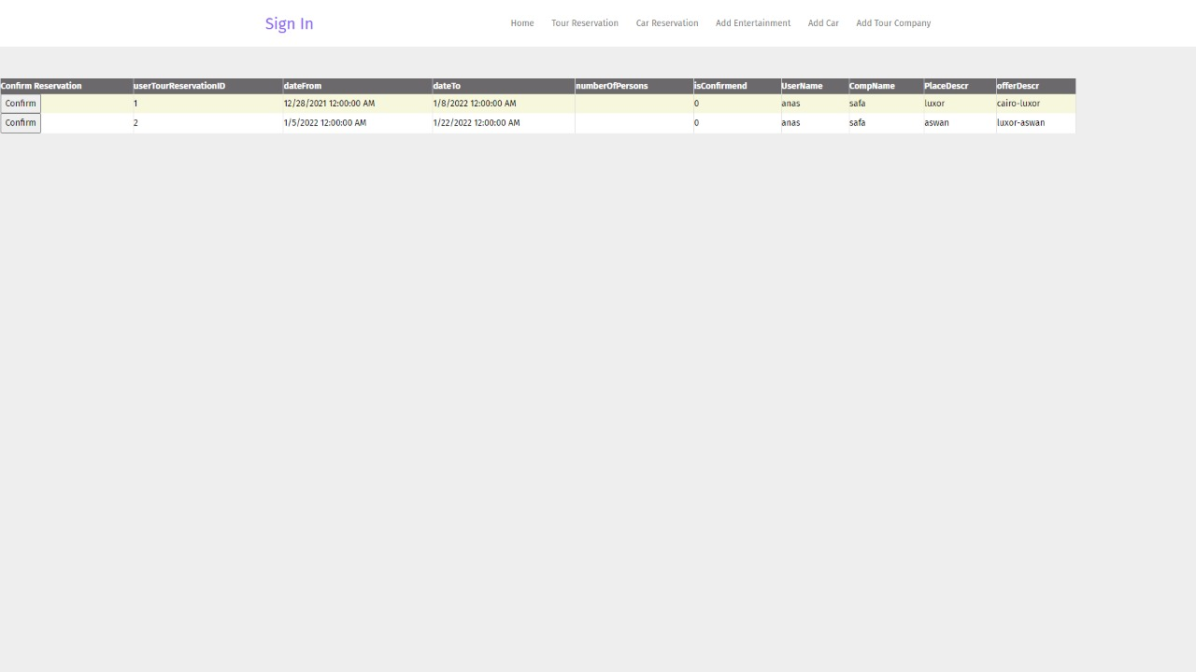
Admin can confirm tour requests

Slide 42
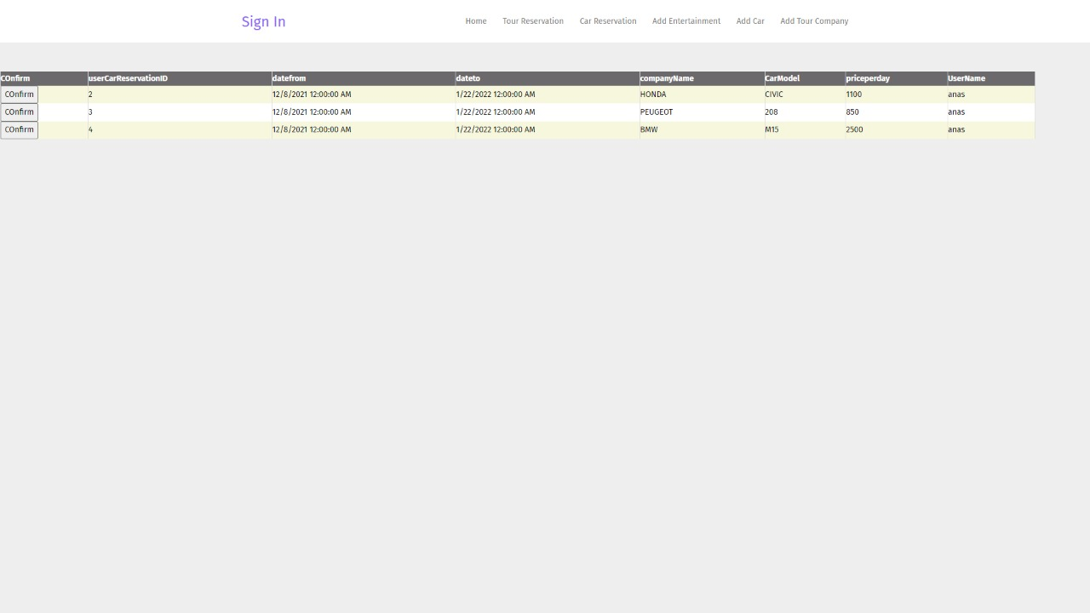
Admin can confirm tour requests

Slide 43
Thank you
Quest is always here to help you

